Slide 1

Documentation Agent Orchestrator
Stop AI from inventing documentation

Slide 2
Documentation Agent Orchestrator introduces governance into AI-assisted documentation. Instead of letting AI “fill gaps” to sound helpful, it enforces strict rules so AI: Documents exactly what is provided, or Stops and asks questions when guessing would be required This shifts AI from a creative assistant to a controlled documentation agent.

Slide 3


The Real Problem with AI in Documentation
AI is fluent. Documentation must be correct.
When AI rewrites documentation, the biggest risk is not grammar or tone.
The real risk is silent meaning change—alterations that look professional but fundamentally alter accuracy.
Invented Features or Behaviors
Implied Steps That Were Never Written
AI describes functionality that doesn't exist, creating false expectations.
Missing procedures are fabricated to create narrative completeness.
Assumed Workflows or Defaults
Changed or "Upgraded" Terminology
AI infers standard behavior patterns that may not match
actual implementation.
Technical terms are modernized or simplified, breaking consistency
with product interfaces.
These changes often look professional and reasonable, which makes them nearly impossible to detect during casual review.

Slide 4
Why This Hurts Technical Writers
When documentation is wrong, the AI is not blamed
In reviews, audits, customer escalations, or incidents:
The AI prompt is not reviewed
AI assumptions are not visible
Documentation is treated as authoritative
Responsibility always falls on the writer.
This creates an imbalance:
AI increases speed
Accountability remains human
That makes AI both powerful and risky in documentation workflows.

Slide 5
Why Existing AI Tools Don’t Solve This
AI tools optimize for helpfulness
“Helpful” usually means:
Filling in gaps
Making content sound complete
Resolving ambiguity automatically
Documentation requires the opposite behavior:
Ambiguity should remain visible
Unknowns should stay unknown
Guessing is worse than stopping
The problem is not poor AI quality. The problem is misaligned behavior.

Slide 6

The Core Idea: Governance Instead of Guessing
AI is allowed only two behaviors
Documentation Agent Orchestrator enforces a strict operational rule that eliminates the middle ground where AI "helps" by making assumptions:
1. Document Exactly What Is Provided
Reproduce source content with precision, preserving ambiguity, gaps, and incomplete information exactly as written.
2. Stop and Ask Clarifying Questions
When documentation would require invention, inference, or assumption, halt processing and explicitly request the missing information.
There is no middle ground. There is no "helpful guessing." This replaces AI creativity with AI restraint—the foundation of trustworthy automated documentation.

Slide 7

Concrete Example: Without vs With Governance
Original Input
Without Governance
With Governance
Credential validation method invented
Output mirrors the source exactly
User clicks login.
Credentials checked.
Valid → dashboard.
Invalid → error.
Admins get extra options.
Ambiguity is explicitly listed
Dashboard behavior assumed
No behavior is invented or inferred
Error handling expanded
Unknowns remain documented as unknowns
"Extra options" turned into specific features
The difference is not style, tone, or formatting. The difference is correctness—the fundamental requirement for technical documentation in regulated industries.

Slide 8
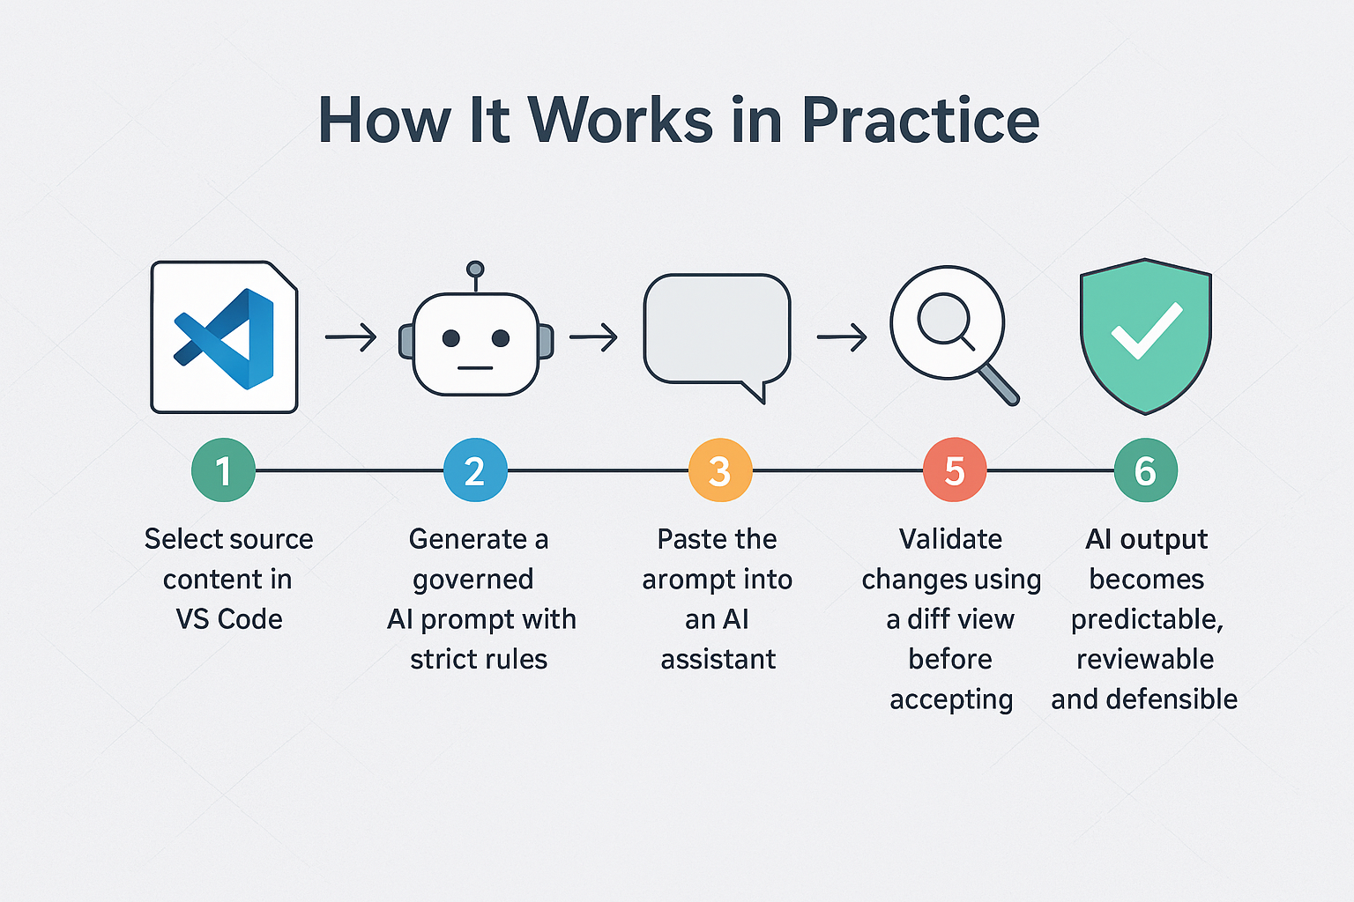

Slide 9
Why This Is a Real Step Forward
A governance layer, not a writing tool
Documentation Agent Orchestrator is:
Not a writing assistant
Not a polishing tool
Not a creativity booster
It is a governance layer for AI-assisted documentation.
It makes AI:
Predictable
Reviewable
Accountable
**It doesn’t make AI smarter.
It makes AI stop lying.**

Slide 10
Who This Is For
Built for people accountable for documentation accuracy
Technical writers
Documentation engineers
Docs-as-code teams
Not designed for:
Content polishing
Grammar correction
Creative rewriting
If you can’t afford AI guessing on your behalf, this approach changes what “safe AI” means for documentation.

